Slide 1
Coding of 3D Kinect Depth Video for Capturing Affective States

Slide 2
Agenda
Introduction
Experimental Methods
Depth Compression
Process Framework
Results
Conclusion
Future Work

Slide 3
Introduction
A Depth image is a 2D image where each pixel’s value encodes the distance between the camera and the object surface at that pixel [1].
Instead of storing intensity or RGB values, a depth image stores geometric information [1].
The raw depth image encodes metric depth values → used for computation, reconstruction, or geometry [2].

Slide 4
Introduction
Depth images are powerful because they add geometric context. Some major applications:
3D Reconstruction & Point Clouds [3]
Segmentation / Foreground–Background Separation[4]

Slide 5
Introduction
Most methods focus primarily on capturing frames rather than storing them efficiently.
Which motivating investigations into methods to compress frames and store them while ensuring high quality, accuracy, and reduced storage requirements.
In this context, finding better ways to compress depth frames has become important for improving how efficiently we can process and transfer data.

Slide 6
Introduction
This research explores several approaches for compressing depth frames captured from Kinect recordings to minimize file size while maintaining visual clarity.
The focus is particularly placed on the tracked human body where high precision is necessary for tasks such as movement analysis and pose estimation.

Slide 7
Experimental Methods
Full-depth frame: The original depth frame is compressed without any changes.
Body frame: Only the human body is extracted from each frame, with the background removed.
3D body reconstruction: Building on (Body frame), a 3D point cloud of the detected human body is reconstructed.

Slide 8
Dataset Description
.mkv videos recorded using Kinect Azure device[7]
RGB 1920 x 1080 , 8 bit @ 30 fps
Depth 640 x 576 , 16 bit @ 30 fps
Metadata (Camera alignment parameters)

Slide 9
Depth Image compression
Depth image compression has gained significant attention due to its various applications.
Traditional lossless compression methods, such as PNG, rely on predictive coding and context modeling to achieve efficient compression.
PNG compression is used because it preserves the image quality while reducing file size[8].

Slide 10
Depth Image compression
Raw Pixel Data
PNG Filtering
DEFLATE Compression
PNG Chunk Construction
PNG File
Raw Pixel Data
Reverse PNG Filters
Decompress Data
Decode PNG Chunk Structure

Slide 11
ROI (Region of Interest) Compression
Foreground-background segmentation has emerged as a crucial technique in depth image compression.
particularly when the goal is to preserve important regions such as humans, while compressing less critical areas more aggressively [6].

Slide 12
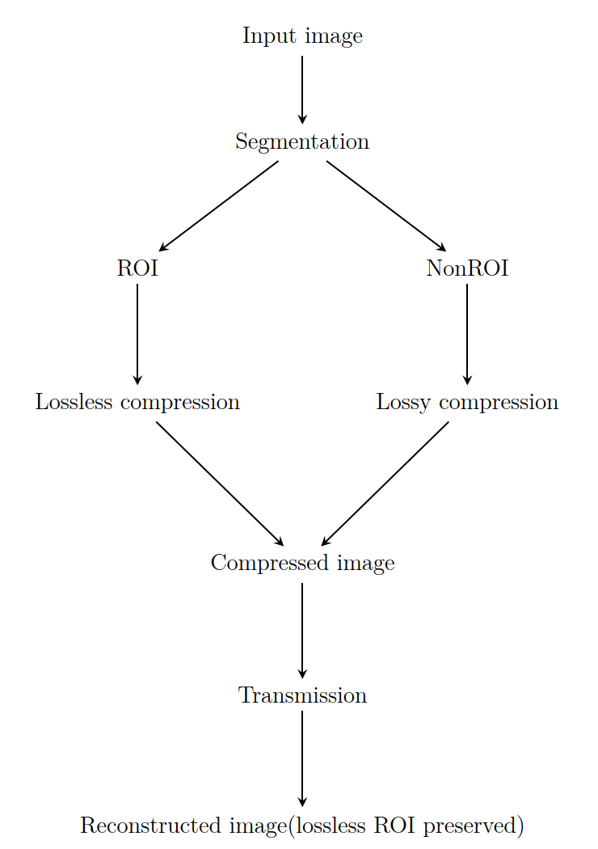
ROI (Region of Interest) Compression

Slide 13
AI-Based Segmentation
Traditional approaches, like simple region-of- interest techniques, typically rely on geometric indications or depth thresholds to separate the foreground from the background.
While these methods can work reasonably well in controlled or static environments, they often struggle in more complex scenes.

Slide 14
AI-Based Segmentation
Traditional methods struggle with complex, varied shapes
Methods like background subtraction or basic feature detection cannot understand the actual shape.
Deep learning models can recognize and interpret different shapes, even when partially hidden, enabling far more accurate detection and segmentation [9].

Slide 15
AI-Based Segmentation
Runs a pre-trained deep neural network that analyzes each depth frame.
Creates a per-pixel mask segmentation.
The output is IndexMap, which shows which pixels belong to each detected object [10].

Slide 16
Octree-Based Compression
With the rise of 3D sensors and depth cameras, compressing depth images and point clouds efficiently has become important.
Traditional lossless formats like PNG preserve exact depth values, but they do not take full advantage of the spatial patterns and redundancies in 3D data, which limits their compression efficiency [11].

Slide 17
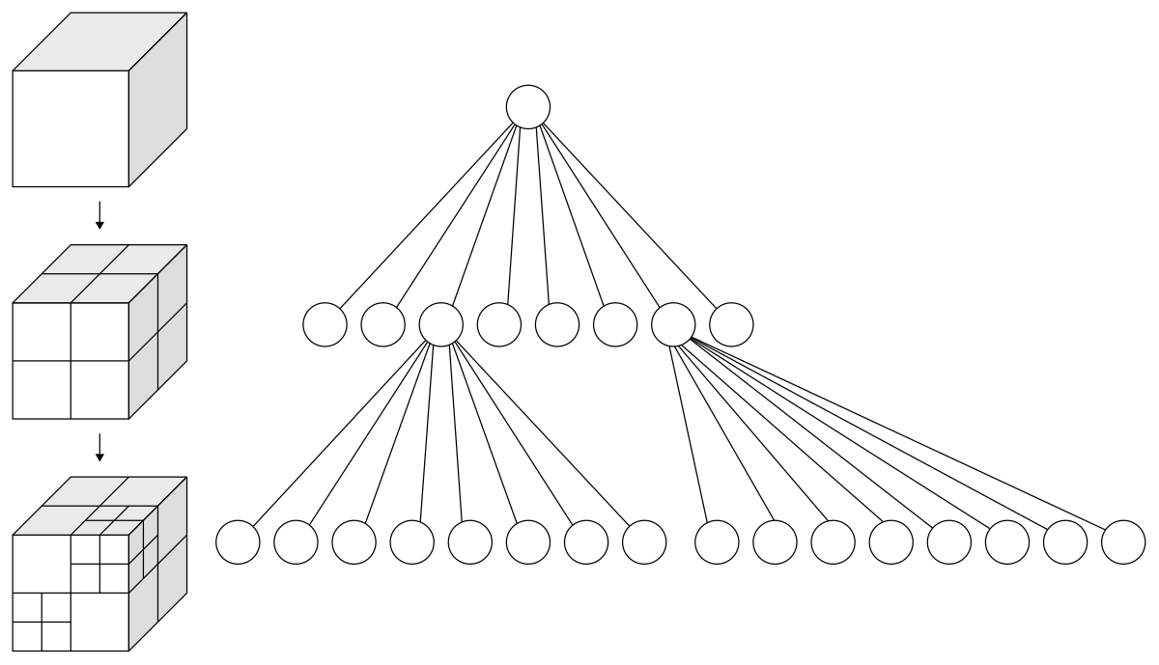
Octree-Based Compression
Notes:
Octree-based compression solves this by organizing the 3D space hierarchically. The process starts by enclosing the entire point cloud or depth map in a single root cube. This cube is then recursively divided into eight smaller octants. For each octant, the algorithm checks whether it contains any points: if it is empty, it is discarded; if it contains points, it is subdivided further. This subdivision continues until either a specified depth is reached or the octant contains a single point.
Decoding simply reverses this process, reconstructing the hierarchy and recovering the points according to their stored positions and subdivision levels. By focusing only on occupied regions and representing them hierarchically, octree-based compression captures fine details efficiently while keeping the file size much smaller than traditional methods.

Slide 18
Process Framework (Method 1)
Input .mkv video
Extract depth frames
PNG codec
Bitstream
Bitstream

Slide 19
Process Framework (Method 2)
Input .mkv video
Human body tracking
Extract human frames
PNG Codec
Bitstream
Bitstream

Slide 20
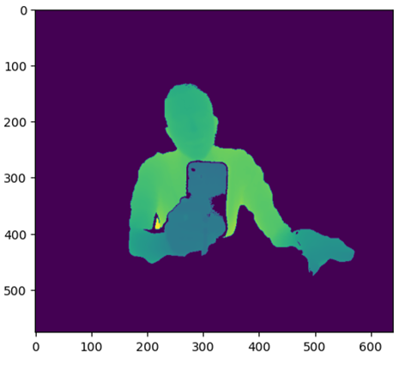
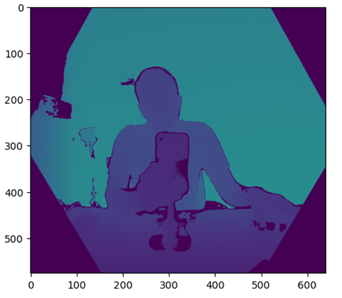
Process Framework (Method 2)

Slide 21
Process Framework (Method 3)
Input .mkv video
Human body tracking
Extract human frames
Point Conversion
Bitstream
Octree Partitioning
Bitstream

Slide 22
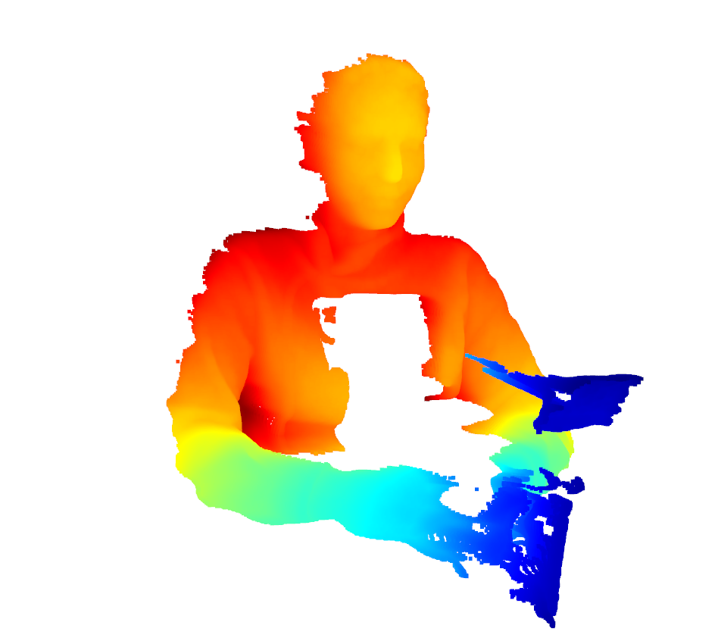
Process Framework (Method 3)

Slide 23
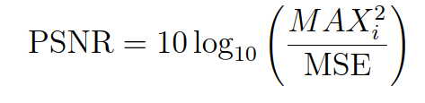
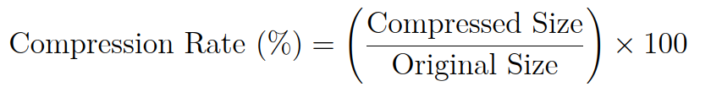
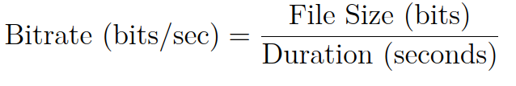
Evaluation Metrics
PSNR
Compression rate
Bitrate

Slide 24
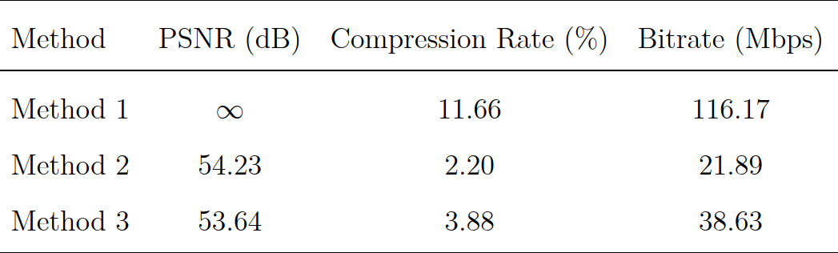
Evaluation Metrics

Slide 25
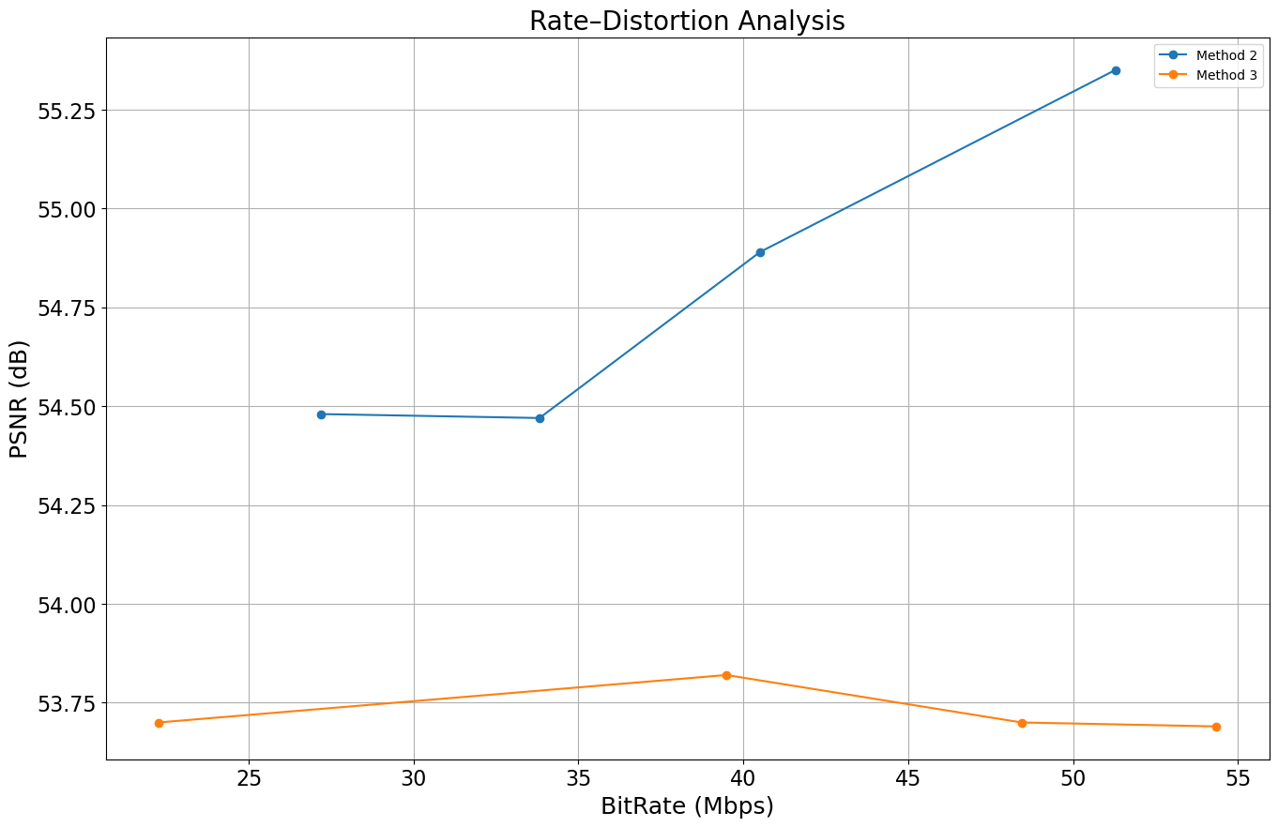
Rate–Distortion Analysis

Slide 26
AI-Based Human Pose Evaluation
Models used:
RT-DETR: detects person, provides bounding boxes
ViTPose: gives accurate 2D keypoints
Purpose:
Compare accuracy between original vs compressed frames

Slide 27
3D Pose Reconstruction Pipeline
Preprocessing
2D Keypoint Estimation
2D → 3D Mapping
Data Output

Slide 28
2D Keypoint Estimation
A bounding box containing the entire person is defined.
The model then estimates 2D human pose information by detecting keypoints representing the major body joints.
For each joint, the model outputs its pixel coordinates (x, y).

Slide 29
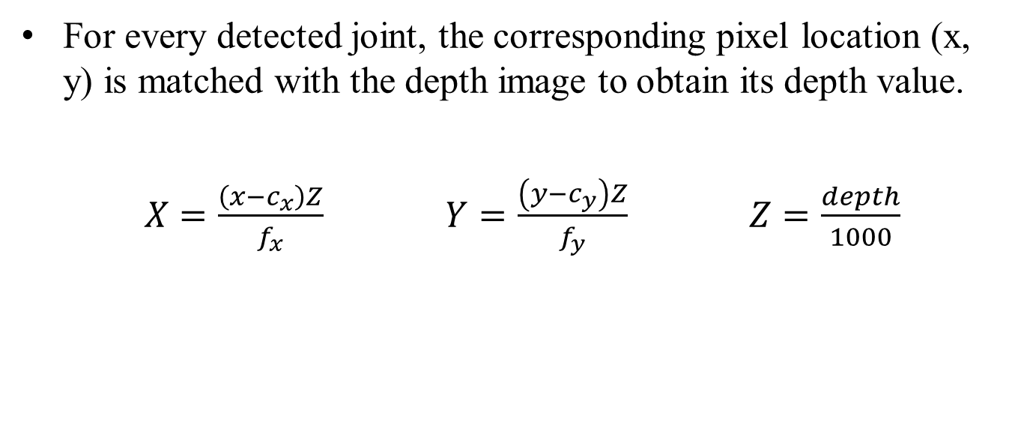
2D → 3D Mapping
For every detected joint, the corresponding pixel location (x, y) is matched with the depth image to obtain its depth value.
$X=\frac{\left(x−c_{x}\right)Z}{f_{x}}$ $Y=\frac{\left(y−c_{y}\right)Z}{f_{y}}$ $Z=\frac{depth}{1000}$

Slide 30
Pose Estimation Accuracy (RMSE)
Video | Method 1 (mm) | Method 2 (mm) | Method 3 (mm)
004-t2-20230303.mkv | 0.00 | 11.00 | 317.18
007-t2-20230309.mkv | 0.00 | 0.50 | 100.15
013-t2-20230317.mkv | 0.00 | 0,42 | 129.10
028-t2-20230322.mkv | 0.00 | 0.85 | 121.62
038-t2-20230303.mkv | 0.00 | 0.21 | 185.60
052-t2-20230704.mkv | 0.00 | 14.16 | 302.51
060-t2-20230703.mkv | 0.00 | 0.45 | 100.00
071-t2-20230804.mkv | 0.00 | 0.82 | 103.50

Slide 31
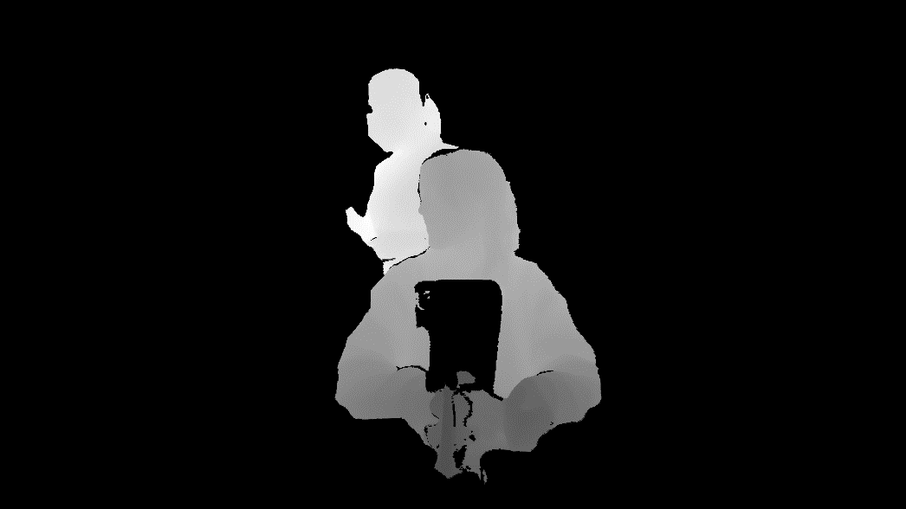
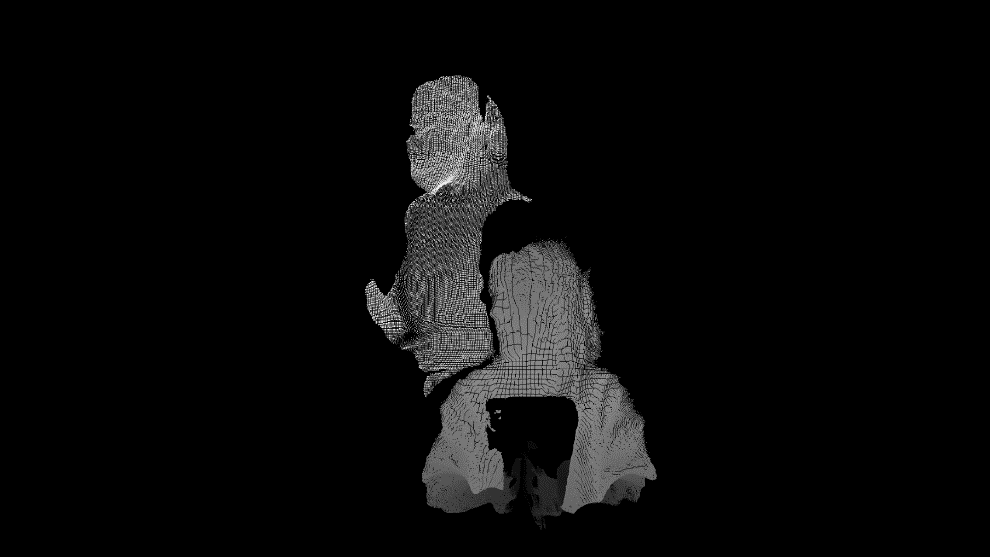
Pose Estimation Accuracy

Slide 32
Performance of Each Method
Method 1 — Full Depth (Lossless)
Accurate
Fast
Method 2 — Body Frame
Highest efficiency
Accurate
Method 3 — Octree
Good visual quality
Slower and heavier to generate

Slide 33
Conclusion
Method 2 (Body Frame Compression) is the best performing method
Achieves high compression rate & high accuracy in 3D coordinate estimation

Slide 34
Future Work
Improve octree encoding reconstruction.
Evaluate the effect of compression using different ML models, such as depression detection models.

Slide 35
References
K. Müller, P. Merkle, and T. Wiegand, “3‑D Video Representation Using Depth Maps,” Proceedings of the IEEE, vol. 99, no. 4, pp. 643–656, Apr. 2011.
Kyung Yong Kim, Gwang Hoon Park, and Doug Young Suh, “Adaptive Depth‑Map Coding for 3D‑Video,” IEICE Transactions on Information and Systems, vol. E93‑D, no. 8, pp. 2262–2272, 2010.
P. Henry, M. Krainin, E. Herbst, X. Ren and D. Fox, “RGB‑D Mapping: Using Depth Cameras for Dense 3D Modeling of Indoor Environments,” 2010.
C.‑H. Chen et al., “Dense 3D Environment Reconstruction with an RGB‑D Camera for Mobile Robot,” in Proc. International PhD Conf. on Safe and Social Robotics (SSR), 2018.
T. Boutell and G. Lane, PNG (Portable Network Graphics) Specification, Version 1.2. W3C/PNG Development Group, 1999.
P. Jangbari and D. Patel, “Review on region of interest coding techniques for medical image compression,” International Journal of Computer Applications, vol. 134, pp. 1–5, 2016.

Slide 36
References
M. Keinert, L. Schindler-Gmelch, L. H. Rupp, M. Sadeghi, K. Capito, M. Hager, F. Rahimi, R. Richer, B. Egger, B. M. Eskofier, and M. Berking, “Facing depression: evaluating the efficacy of the empkins-ekspression reappraisal training augmented with facial expressions – protocol of a randomized controlled trial,” BMC Psychiatry, vol. 24, p. 896, 2024.
T. Boutell and G. Lane, PNG (Portable Network Graphics) Specification Version 1.0, ISO/IEC 15948:2003, W3C, 2003.
T. Zhou, F. Porikli, D. J. Crandall, L. Van Gool and W. Wang, “Deep learning for video object segmentation: a review,” Artificial Intelligence Review, vol. 56, pp. 457–531, 2023.
W. Wang and U. Neumann, “Depth-aware CNN for RGB-D Segmentation,” in Proc. European Conference on Computer Vision (ECCV), 2018, pp. 135–150.
L. Liu, Z. Hu, and Z. Chen, “Towards point cloud compression for machine perception: A simple and strong baseline by learning the octree depth level predictor,” arXiv preprint arXiv:2406.00791, 2024.

Slide 37

Thank you! I’m happy to take any questions.

